Slide 1
Plasma amyloid-β biomarker for Alzheimer's disease
Student: Shuai Zhu
Advisor: Nichole Carlson

Slide 2
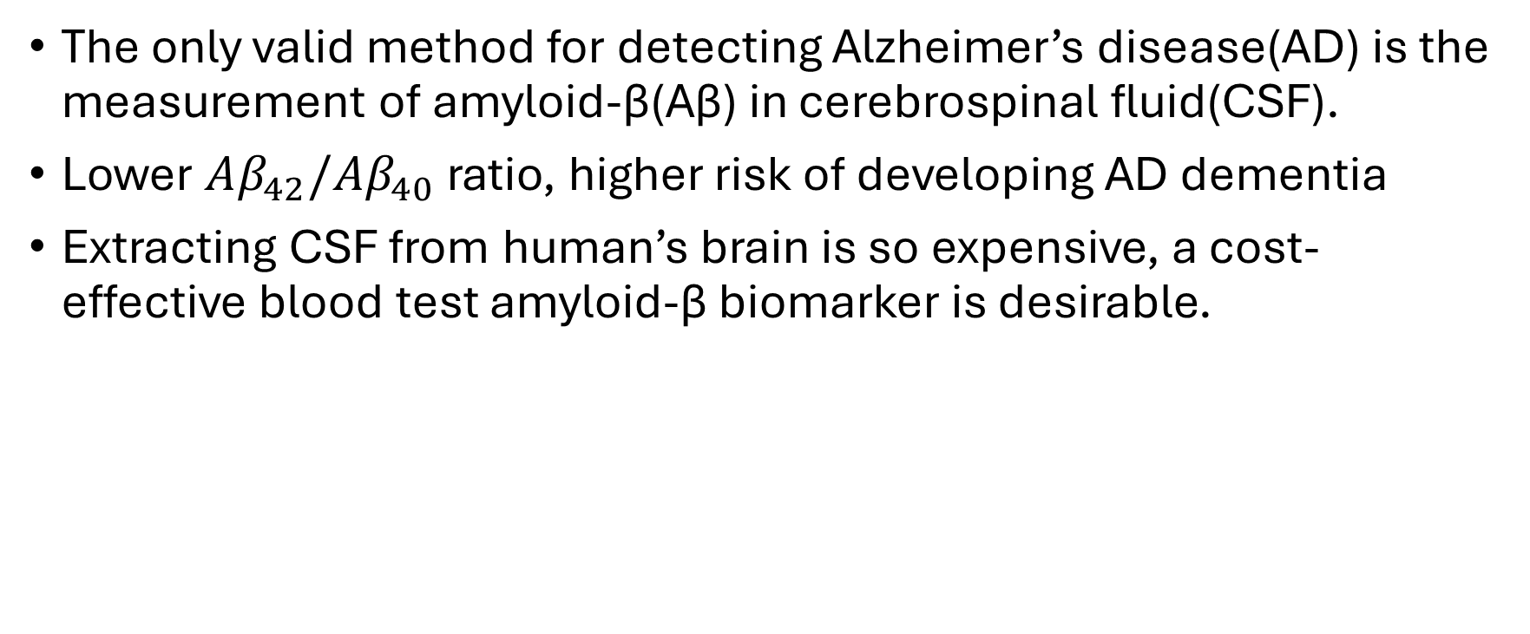
Introduction
The only valid method for detecting Alzheimer’s disease(AD) is the measurement of amyloid-β(Aβ) in cerebrospinal fluid(CSF).
Lower $Aβ_{42}/Aβ_{40}$ ratio, higher risk of developing AD dementia
Extracting CSF from human’s brain is so expensive, a cost-effective blood test amyloid-β biomarker is desirable.

Slide 3
Data
The sample of CSF and plasma are from Longitudinal Innate Immunity and Aging(LIIA) cohort.
Older adults who are 60 years or older, In good general health, and have not been diagnosed with a memory disorder was recruited to LIIA study.
We only use baseline data.

Slide 4
Descriptive analysis

